Slide 1
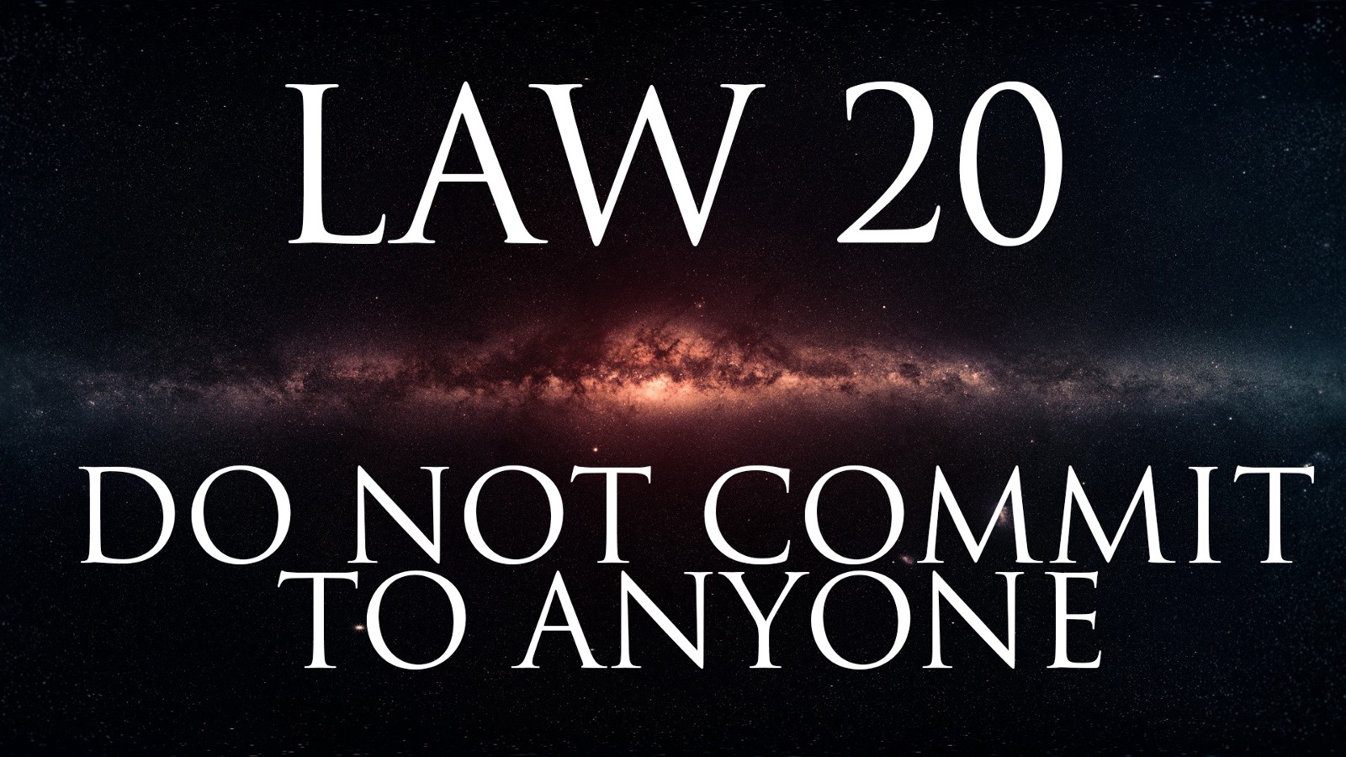

Slide 2
JUDGMENT:
It is the fool who always rushes to take sides. Do not commit to any side or cause but yourself. By maintaining your independence, you become the master of others— playing people against one another, making them pursue you.

Slide 3
By not committing By committing
YOU WILL BE FREE JUST LIKE A FLYING BIRD IN AIR AND YOU WILL BECOME THE MASTER ON OTHER PEOPLES
YOU WILL BECOME LIKE A BIRD IN CAGE DEPENDENT ON OTHERS AND OTHER WILL BE YOUR MASTRES.

Slide 4
BASICALLY THIS LAW HAS TWO PARTS:
DO NOT COMMIT TO ANYONE BUT BE COURTED BY ALL.
DO NOT COMMIT TO ANYONE STAY ABOVE TO FRAY.

Slide 5
Do Not Commit To Anyone but Be Courted By All If you allow to feel they possess you to any degree, you lose all power over them. By not committing your affections, they will only try harder to win you over. Stay aloof and you gain the power that comes from their attention and frustrated desire. Play the virgin Queen: Give them hope but never satisfaction.

Slide 6
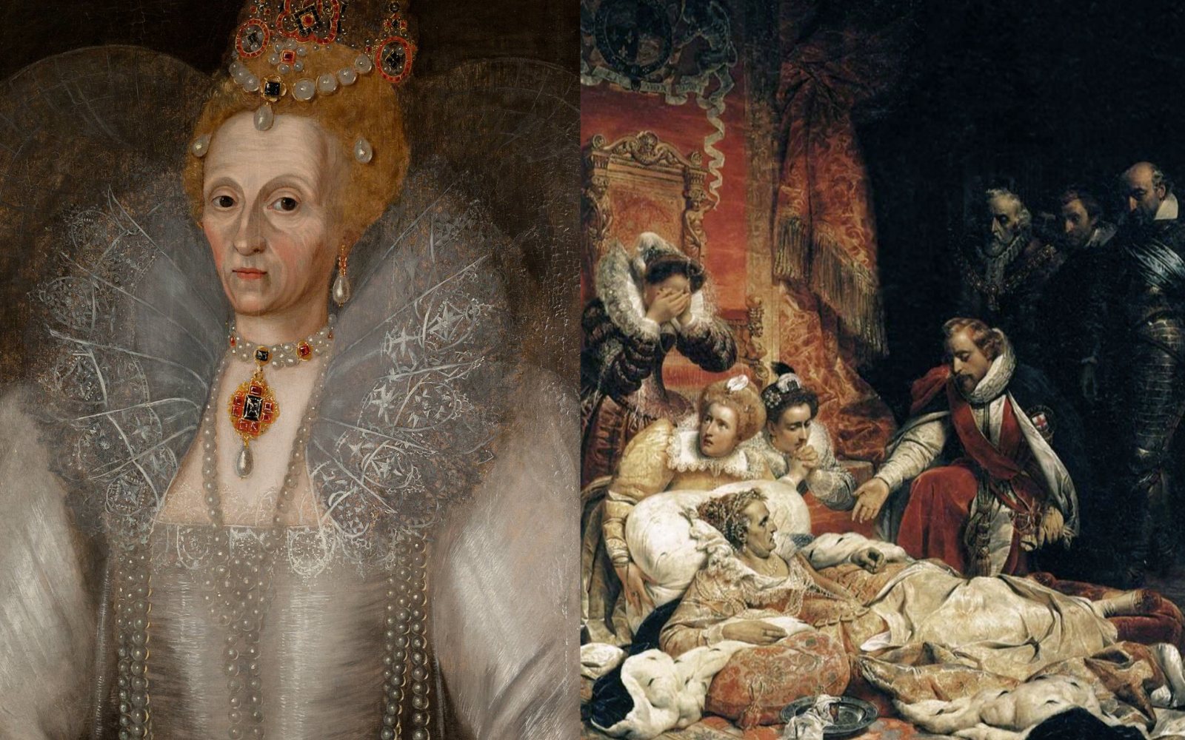
OBSERVANCE OF THE LAW
In 1558 , she become young and beautiful, Everymen wants to merry with her.
The issue was debated in parliament and was the main topic of conversation.
They advice her to should marry as soon as possible. for a queen must a king and must bear heirs for the kingdom.
Queen Elizabeth 1

Slide 7
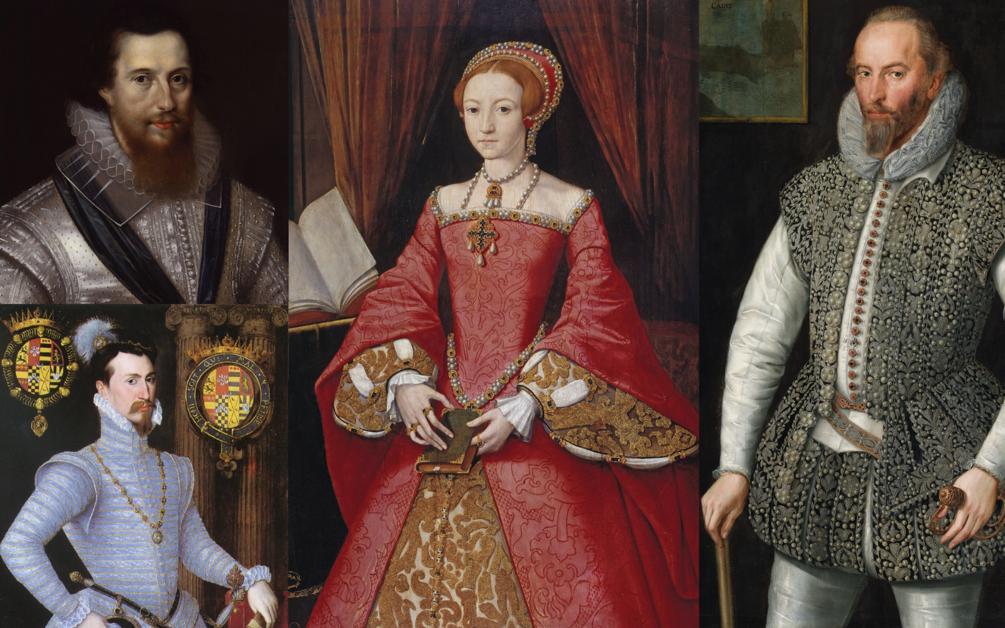
Sir Robert Dudley, the king of Spain , prince of Sweden also wants to marry with her, but she politely refuse them all.
She died the virgin Queen.
“I would rather be a beggar and single then a queen and married. “
Queen Elizabeth 1(1533-1603).

Slide 8
IMAGE:
THE VIRGIN QUEEN .
The center of attention, desire, and worship. Never succumbing to suitor or the other, the Virgin Queen keeps them all resolving around her like planets, unable to leave her orbit but never getting any closer to her.

Slide 9
Do not commit to anyone stay above to fray:
Do not let people drag you into their petty fights and squabbles. Seem interested and supportive, but find a way to a remain neutral; let others do the fighting while you stand back, watch and wait. When the fighting parties are good and tired they will be ripe for the picking. You can make it a practice, in fact, to stir up quarrels between other people, and then offer to mediate, gaining power as the go –between.

Slide 10
You should not involve yourselves in others Squabbles, keep yourselves away from fray but show that you are intrested in them, but find away to remain neutural.YOU SHOULD NOT.

Slide 11
CONCLUSION: So from the above both parts of this law we can conclude that; D o not disheart anyone. Try to show a very good behavior towards people, Does not matter if you hate them by heart . No one is useless in this world, You actually don’t know anyone can help you anytime.

Slide 12


